Slide 1

Collections - Part 2
M1-D8
Participate! The more engagement the better! You are NEVER interrupting me!

Slide 2
Objectives
Maps
Sets
Other Collection Types(TreeMap, Queue, Stack)

Slide 3
Class Discussion
So you have been tasked to write a program to keep track of the number of homes that are listed for sale by zip code.
How could we solve this with what we know so far ?
zip | Qty on hand
43035 | 5
43017 | 12

Slide 4

Map<Type, Type>
A map is an indexed collection that allows values to be located using user-defined keys.
A key is used to reference values stored in the map
Keys must be unique! No duplicates.
But we can have duplicate values
key
value
sku | quantity
291 | 12
121 | 35

Slide 5
How to declare and instantiate map
Map<String, String> inventory = new HashMap<String, String>();
Datatype of the key
Datatype of the value
key
value
Map is an interface
HashMap is an implementation
sku | quantity
“56271-ABC” | “Widgets”
73526 | “ten”
Map<Integer,String> orders = new HashMap<Integer,String> ();

Slide 6
How to declare and instantiate map
Map<String, String> stateCodeMap = new HashMap<String, String>();
Datatype of the key
Datatype of the value
key
value
code | description
“OH” | “Ohio”
“TX” | “Texas”

Slide 7
How to declare and instantiate map
Map<Integer, String> errorMap = new HashMap<Integer, String>();
Datatype of the key
Datatype of the value
key
value
errorCode | description
100 | “Low Balance”
200 | “Negative Balance”

Slide 8
How to put things in a map
Map<Integer, Integer> inventory = new HashMap<Integer, Integer>();
Datatype of the key
Datatype of the value
key
value
//Integer sku1 = new Integer(56271);
inventory.put(56271, 5); Integer sku2 = new Integer(73526);
inventory.put(sku2, new Integer(14));
//inventory.put(sku2, new Integer(27));
sku | quantity
56271 | 5
73526 | 14

Slide 9
How to get values out of the Map
Map<Integer, Integer> inventory = new HashMap<Integer, Integer>();
Datatype of the key
Datatype of the value
key
value
Integer sku = new Integer(56271);
Integer qty = inventory.get(sku);
sku | quantity
56271 | 5
73526 | 14
If an item is NOT FOUND in a map, the get method will return null.

Slide 10
How to see if a map contains a value
Map<String, String> stateCodes = new HashMap<String, String> ();
stateCodes.put("OH", "Ohio");
stateCodes.put("TX", "Texas");
stateCodes.put("FL", "Florida");
if (stateCodes.containsKey("TX")) {
System.out.println("We found Texas!");
}
key
value
state_code | value
OH | Ohio
TX | Texas
FL | Florida

Slide 11
How to replace or update a value in a map
Map<String, String> stateCodes = new HashMap<String, String> ();
stateCodes.put("OH", "Ohio");
stateCodes.put("TX", "Texas");
stateCodes.put("FL", "Florida");
stateCodes.put(“TX”, “South Oklahoma”);
Before
After
state_code | value
OH | Ohio
TX | Texas
FL | Florida
state_code | value
OH | Ohio
TX | South Oklahoma
FL | Florida

Slide 12
How to remove a value from a map
Map<String, String> stateCodes = new HashMap<String, String> ();
stateCodes.put("OH", "Ohio");
stateCodes.put("TX", "Texas");
stateCodes.put("FL", "Florida");
stateCodes.remove(“TX”);
Before
After
state_code | value
OH | Ohio
TX | Texas
FL | Florida
state_code | value
OH | Ohio
FL | Florida

Slide 13
Set<Type>
A HashSet is an unordered collection of objects in which duplicate values cannot be stored. All values in the set are unique.
Set<String> students = new HashSet<String>();
students.add("Jim");
students.add("Seth");
students.add("Dan");
students.add("Jim"); // this value will be ignored because it is duplicate
Jim Seth Dan

Slide 14
How to iterate through a map using Set (Option 1)
Map<String, String> stateCodes = new HashMap<String, String> ();
stateCodes.put("OH", "Ohio");
stateCodes.put("TX", "Texas");
stateCodes.put("FL", "Florida");
Set<String> keys = stateCodes.keySet(); // returns a Set of all of the keys in the Map
for (String key : keys) {
System.out.println(key + " is the key to lookup " + stateCodes.get(key));
}

Slide 15
How to iterate through a map using Map.Entry(Option 2)
Map.Entry - This represents an ‘entry’ in the map (both the key AND the value) entrySet() - is a list of entries.
for (Map.Entry<String, String> nameZip : nameToZip.entrySet()) {
System.out.println(nameZip.getKey() + " lives in " + nameZip.getValue());
}
// Declaring and initializing a Map
Map<String, String> nameToZip = new HashMap<String, String>();
// Adding an item to a Map
nameToZip.put("David", "44120");
nameToZip.put("Dan", "44124");
nameToZip.put("Elizabeth", "44012");

Slide 16
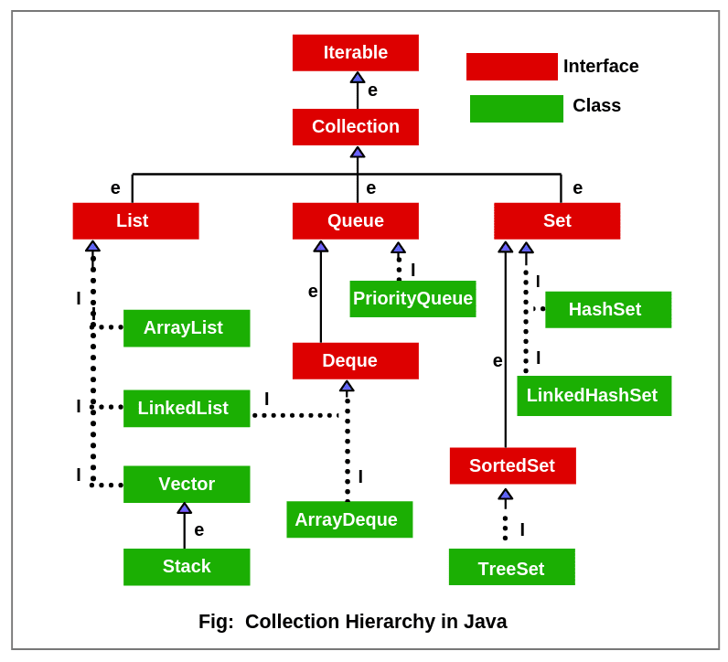
Other collection types

Slide 17
Other Types of Maps and Sets
There are other implementations of Maps and Sets that are good to be aware of but not as common: TreeSet or TreeMap
Set/Map will be sorted (ascending, natural, or the one specified by you via its constructor)
LinkedHashSet/LinkedHashMap
Set/Map will maintain insertion order
Note: You work with these using the same methods as the HashMap/HashSet.

Slide 18
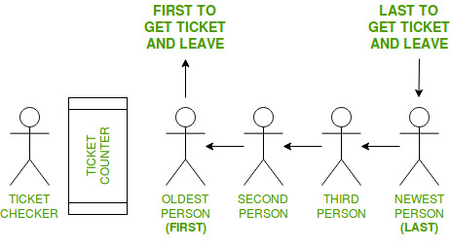
Queues
Queues are simply a List with a special behavior. They follow a FIFO pattern. FIFO is an abbreviation for first in, first out. It is where the first element put into the queue is processed first and the newest element is processed last.

Slide 19
Queues
Queues are simply a List with a special behavior. They follow a FIFO pattern.
Queue<String> priorities = new LinkedList<String>();
priorities.offer("Clean the dishes");
priorities.offer("Wash the counters");
priorities.offer("Sweep the floor");
while (priorities.size() > 0) {
String nextPriority = priorities.poll();
System.out.println("NEXT PRIORITY:" + nextPriority);
}
Basic queues are implemented using the LinkedList offer and poll methods.
The offer method is how we get things on the queue. They go in based on the order you put them in… “Clean the dishes” is first in line, etc..
The poll method is how we process the queue. Clean the dishes is processed first, then Wash the counters
The size method tells us how many items are available in the queue.

Slide 20

Stacks
Stacks are another List that enforces a special behavior. They follow a LIFO pattern. LIFO is an abbreviation for last in, first out. It is where the first element put into the stack is processed last. Any new items added the stack get processed first with the last one added always being the first to get processed. Stack<String> browserStack = new Stack<String>();
browserStack.push("http://www.google.com");
browserStack.push("http://www.cnn.com");
browserStack.push("http://www.google.com");
"http://www.google.com"
"http://www.cnn.com"
"http://www.google.com"
3
2
1

Slide 21
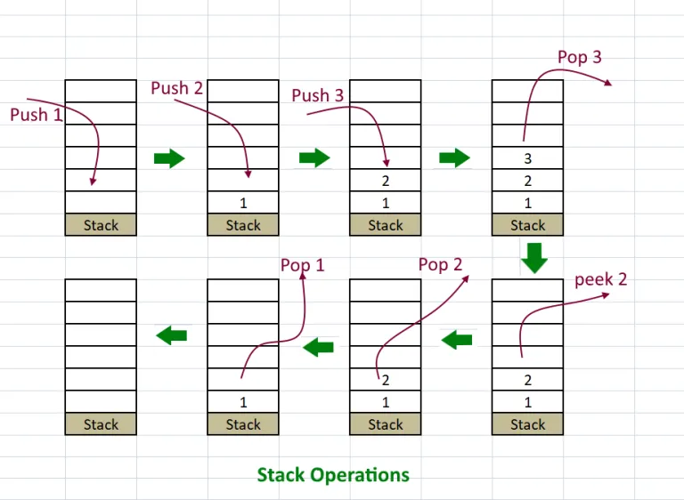
Stacks
The push method pushes things on the stack: The pop method removes the top item from the stack
The peek method just looks to see what is next to be grabbed, but does not remove it.

Slide 22
Stacks
The pop method removes the top item from the stack
The peek method just looks to see what is next to be grabbed, but does not remove it.
while (browserStack.size() > 0) {
String previousPage = browserStack.pop();
System.out.println("PREVIOUS PAGE: " + previousPage);
}
String nextItem = browserStack.peek()

Slide 23

What are the differences between a Stack and a Queue?

